Slide 1



Jason W. Karl, Ph.D.
Jeffrey K. Gillan
Ty Montgomery
Richard Bliss
3 July 2013

Slide 2
Geographic-based literature searching
Results
Theme
Place name
General context
Semantic search
Relevant to theme
Relevant by similar ecological context
Relevant to location
Question: e.g., soil erosion in North American Southwest
Specific location
Ecologically similar areas
Geo-semantic search

Slide 3
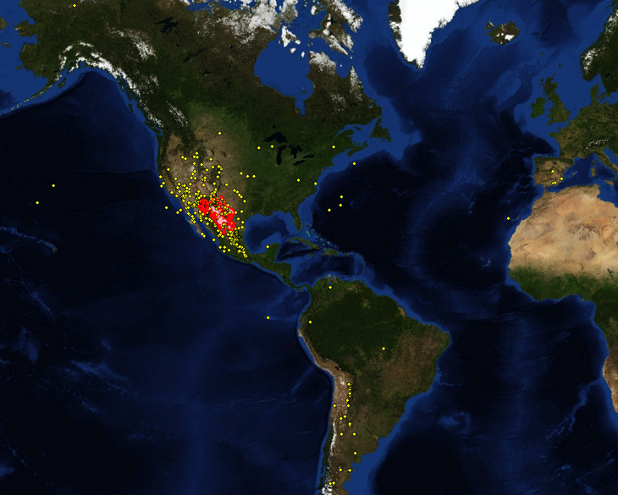
Example: Chihuahuan Desert Ecology Studies
Web of Knowledge Search for “Chihuahuan Desert” in ecology journals. 784 articles could be mapped
282 (36%) actually in Chihuahan Desert
Doesn’t represent myriad articles in the area not using place name term

Slide 4
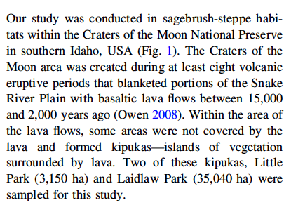
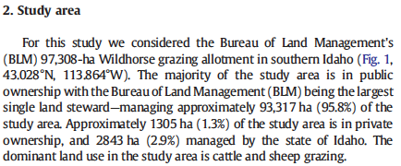
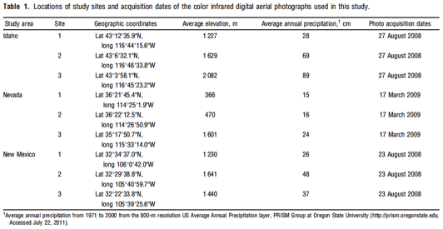
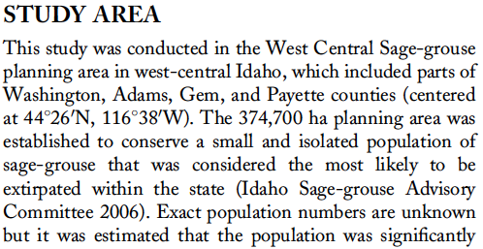
Challenge: Extracting location information from published studies

Slide 5
Mutual Goals
Initiate a pilot project with Taylor & Francis
Develop a workflow/system for large-scale article geo-tagging
Demonstrate “automated” article geo-tagging
Determine cost effectiveness of article geo-tagging
Define services for sharing JournalMap data with other sites
Promote idea of geographic literature searching
Demonstrate value of idea with a large number of articles
Increase ease of literature discovery and relevance of search results

Slide 6
Automating article geo-tagging
Parse Citation, Abstract, Kwds
NLM-formatted XML
Attribute locations with spatial layer info
Upload to JMap
Yes
Parse Coordinates
Coords. Found?
No
Geometry Creation with map interface
JournalMap Database
Attribute locations with spatial layer info

Slide 7
Version 2 Development

Slide 8
Version 2 Development
Online Content Entry
Simplify, speed-up article geo-tagging
Automated retrieval of citation information via DOI
Easy geo-tagging
Geocoding services
Location digitizing
Coordinate correction

Slide 9
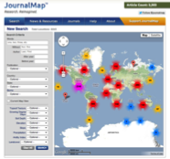
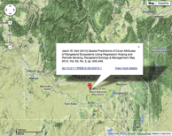
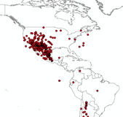
JournalMap Access Options
JournalMap Website
JournalMap Database
Embedded Map Widget
Custom, Embedded Search Interface
?
Other…
Web Map Service

Slide 10
JournalMap Timeline
August 2013
Release JournalMap v2 website
Publication of Geo-Semantic Search article (BioScience)
Fall 2013
Initiate T&F pilot project
Marketing JournalMap & geo-semantic search idea
Content entry
Develop JournalMap data services
Winter 2013/2014
Complete T&F pilot – review outcomes
Workshop – location publication standards

Slide 11
Next Steps
Shared
Finalize T&F pilot project
Define JournalMap data services (embedding/sharing)
Jornada/The Other Firm
Finish/release JournalMap v2 – content entry system
Develop JournalMap data services
Geo-tag journal articles
Track traffic through JournalMap data services
Coordinate efforts to define location reporting standards
Taylor & Francis
Finalize pilot approval
Provide article XML/access
Help define location reporting standards

Slide 13
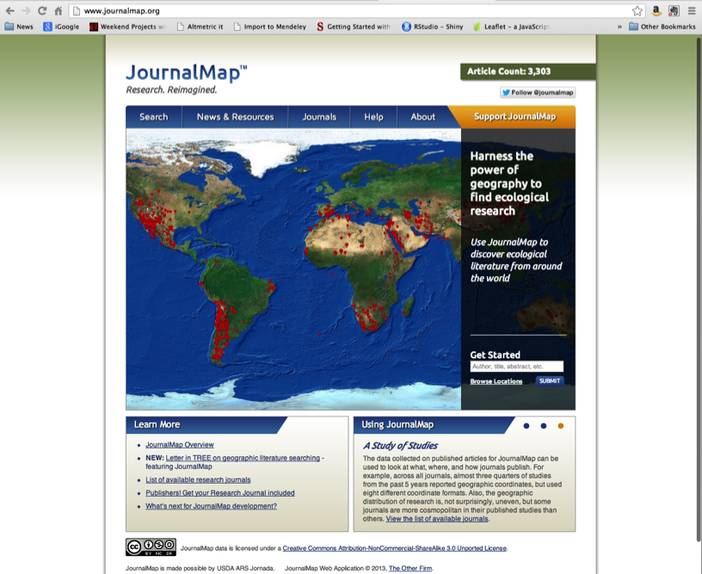

Slide 14
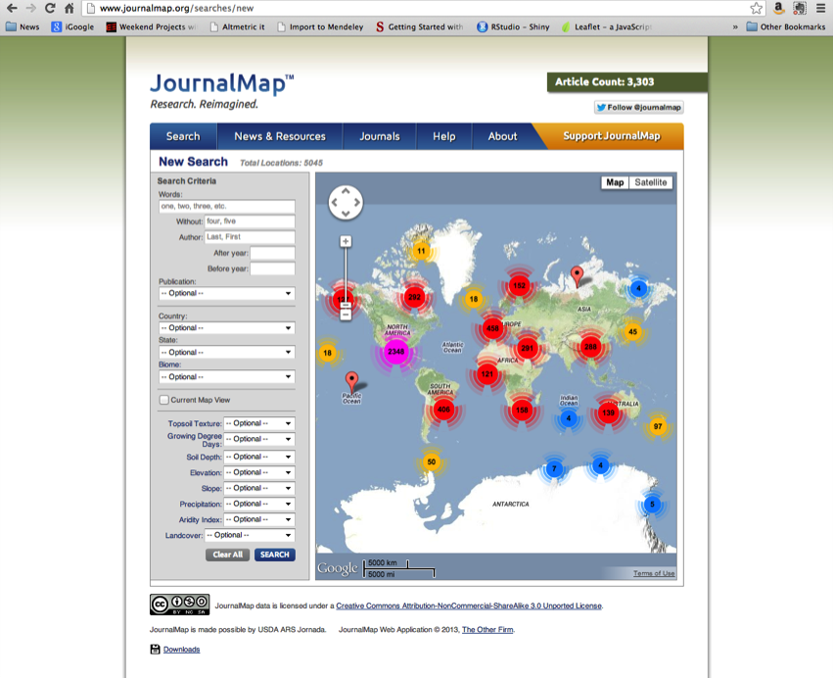

Slide 15
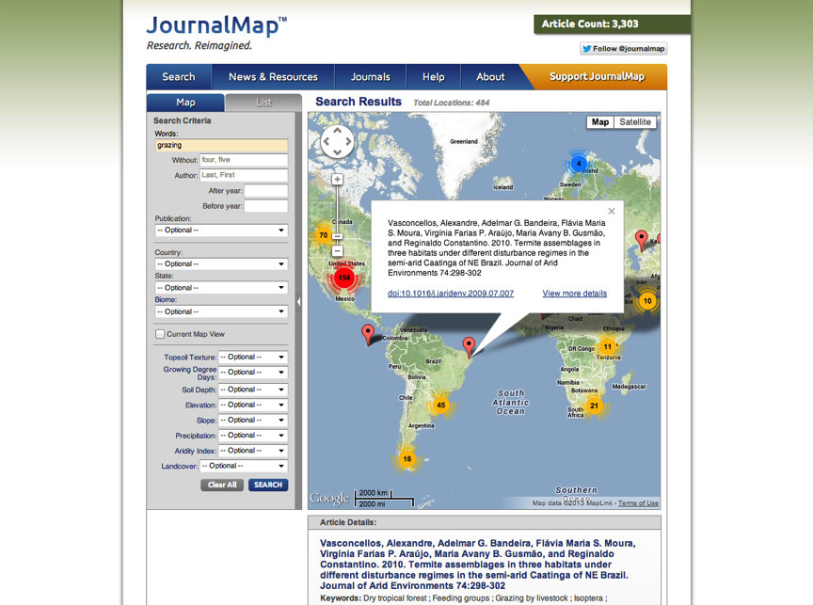

Slide 16
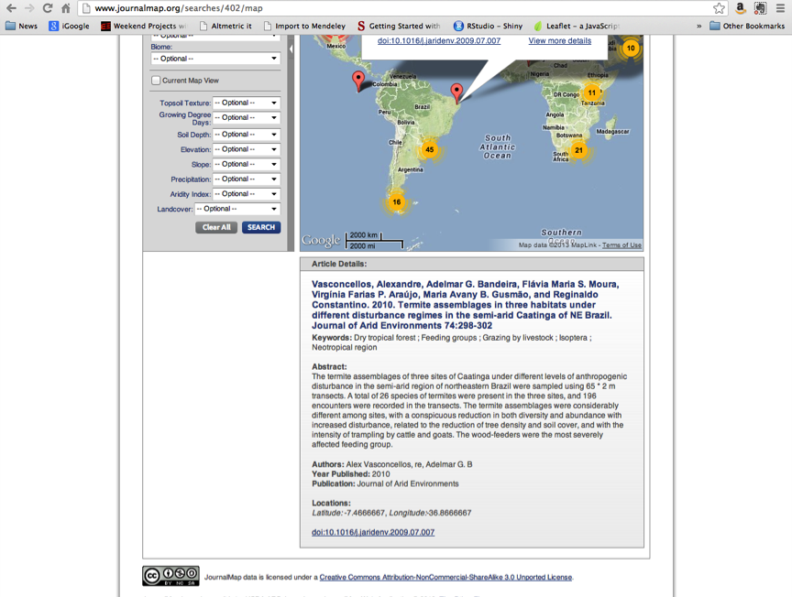

Slide 17
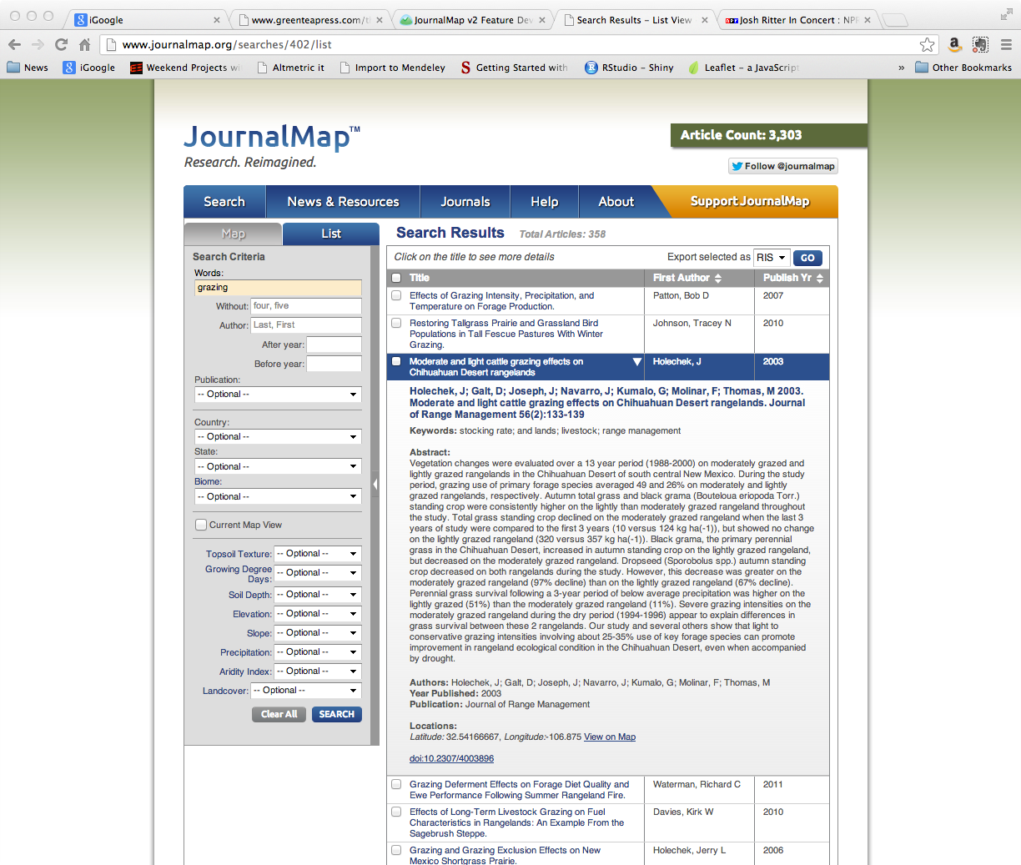

Slide 18
